Slide 1
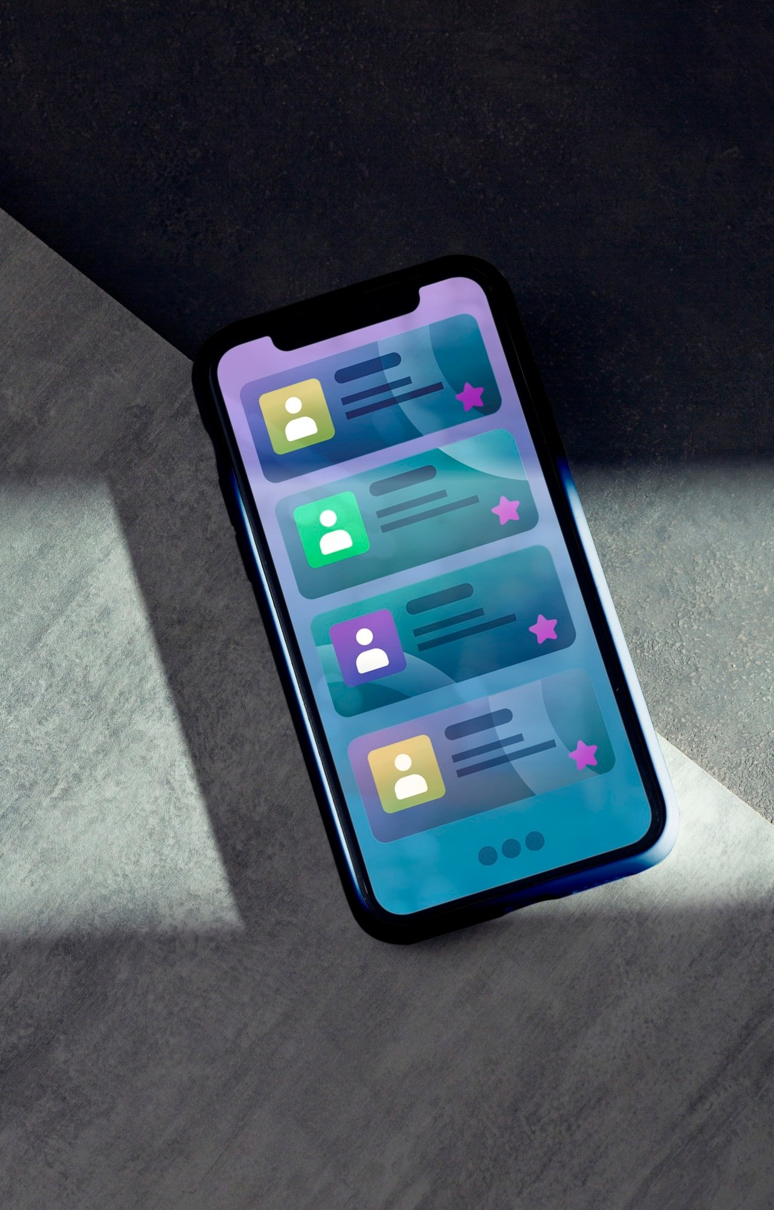
Building a Real- Time Chat Application: A Comprehensive Guide with React, Node.js, MongoDB, and Socket.io

Slide 2
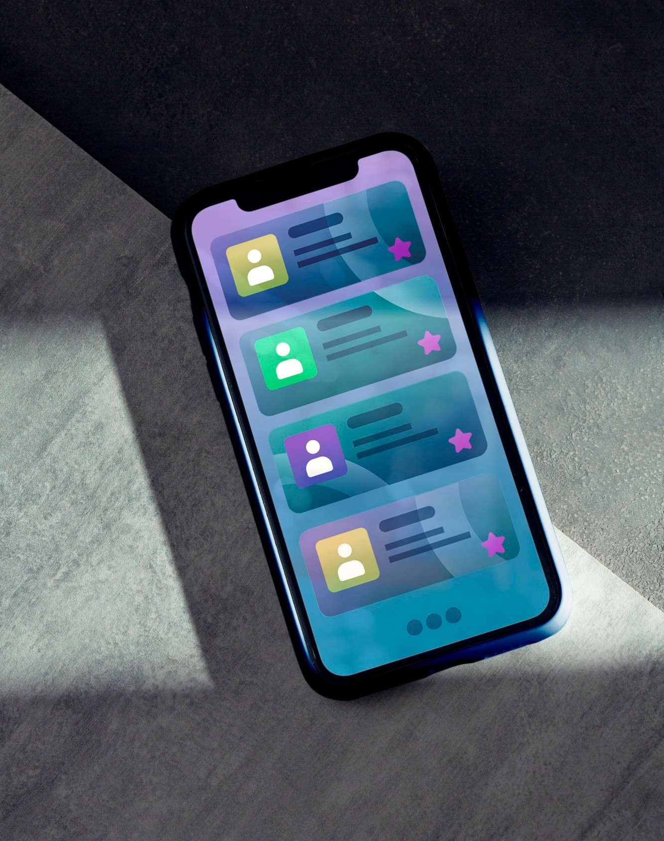






Introduction to Real-Time Chat
In this presentation, we will explore how to build
a using ,
, and . This guide will cover
,
the essential components, architecture, and coding practices to create a and
chat solution.

Slide 3
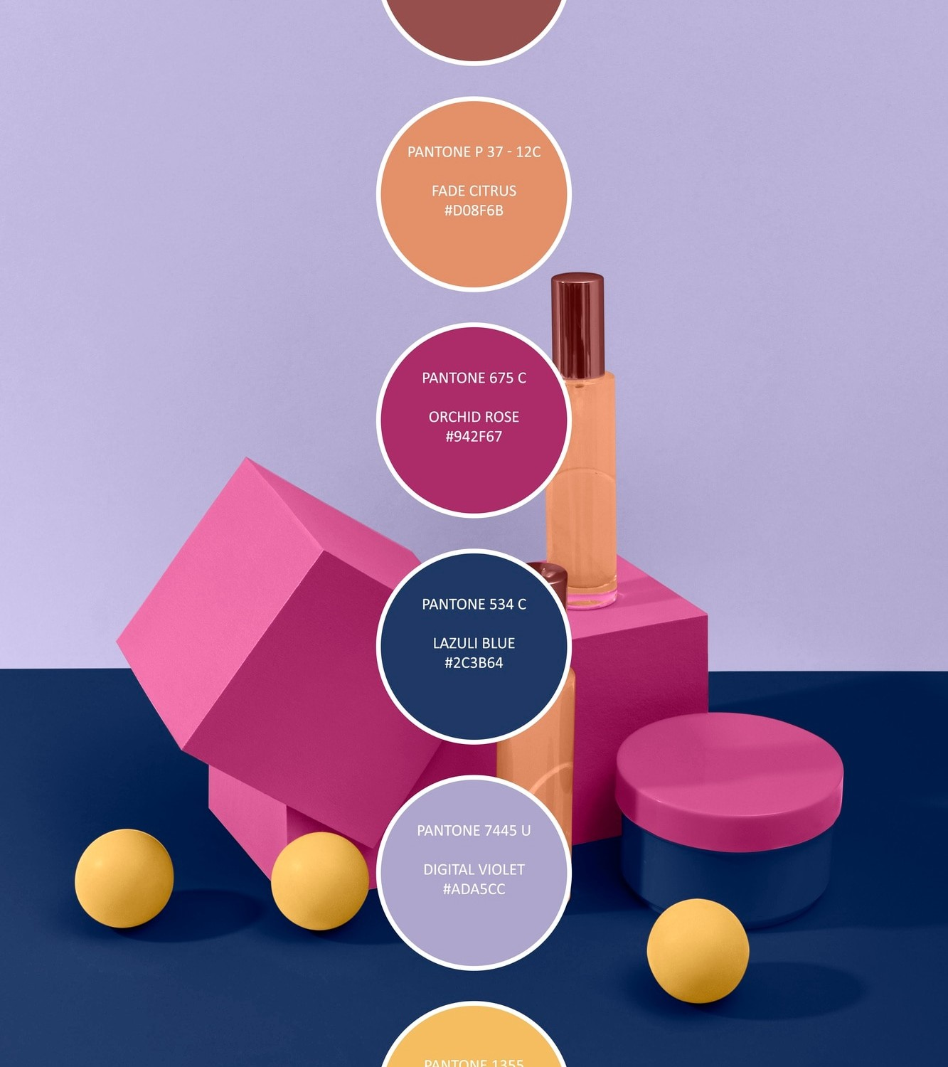









Technology Stack Overview
Our chat application utilizes a
powerful handles the
.
, providing a
dynamic user interface.
serves as the server-side logic.
, managing
is used
for management, while enables
between clients
and the server.

Slide 4







Setting Up the Environment
To start building our application, we need to set up our
. This includes installing
, creating a new setting up
conﬁgure
app, and
. We will also for real-time
communication, ensuring all components are ready for
development.

Slide 5







Building the Frontend
The
built using
of our chat application is
. We will create
components for
, and
,
. Utilizing
, we
and
ensure smooth interactions and dynamic updates as users send and receive messages.

Slide 6



Implementing Real-Time Features
To enable ,
we integrate into our application. This allows users to send and receive messages instantly. We will cover how to set up connections, manage events, and handle user notiﬁcations for a seamless chat experience.

Slide 7






Conclusion and Next Steps
In conclusion, we have covered the essential steps to build a
using , , , and . With this foundation, you can expand features like , , and . Start
building your own chat application today!

Slide 8
Thanks!
RAGHAV BHANDARI 21100BTCSFBI09655 SOUMYA SONI 21100BTCSFBI09665 SHRIYA PANDEY 21100BTCSFBI09663 TANISHKA SAHU 21100BTCSFBI09668

